Slide 1
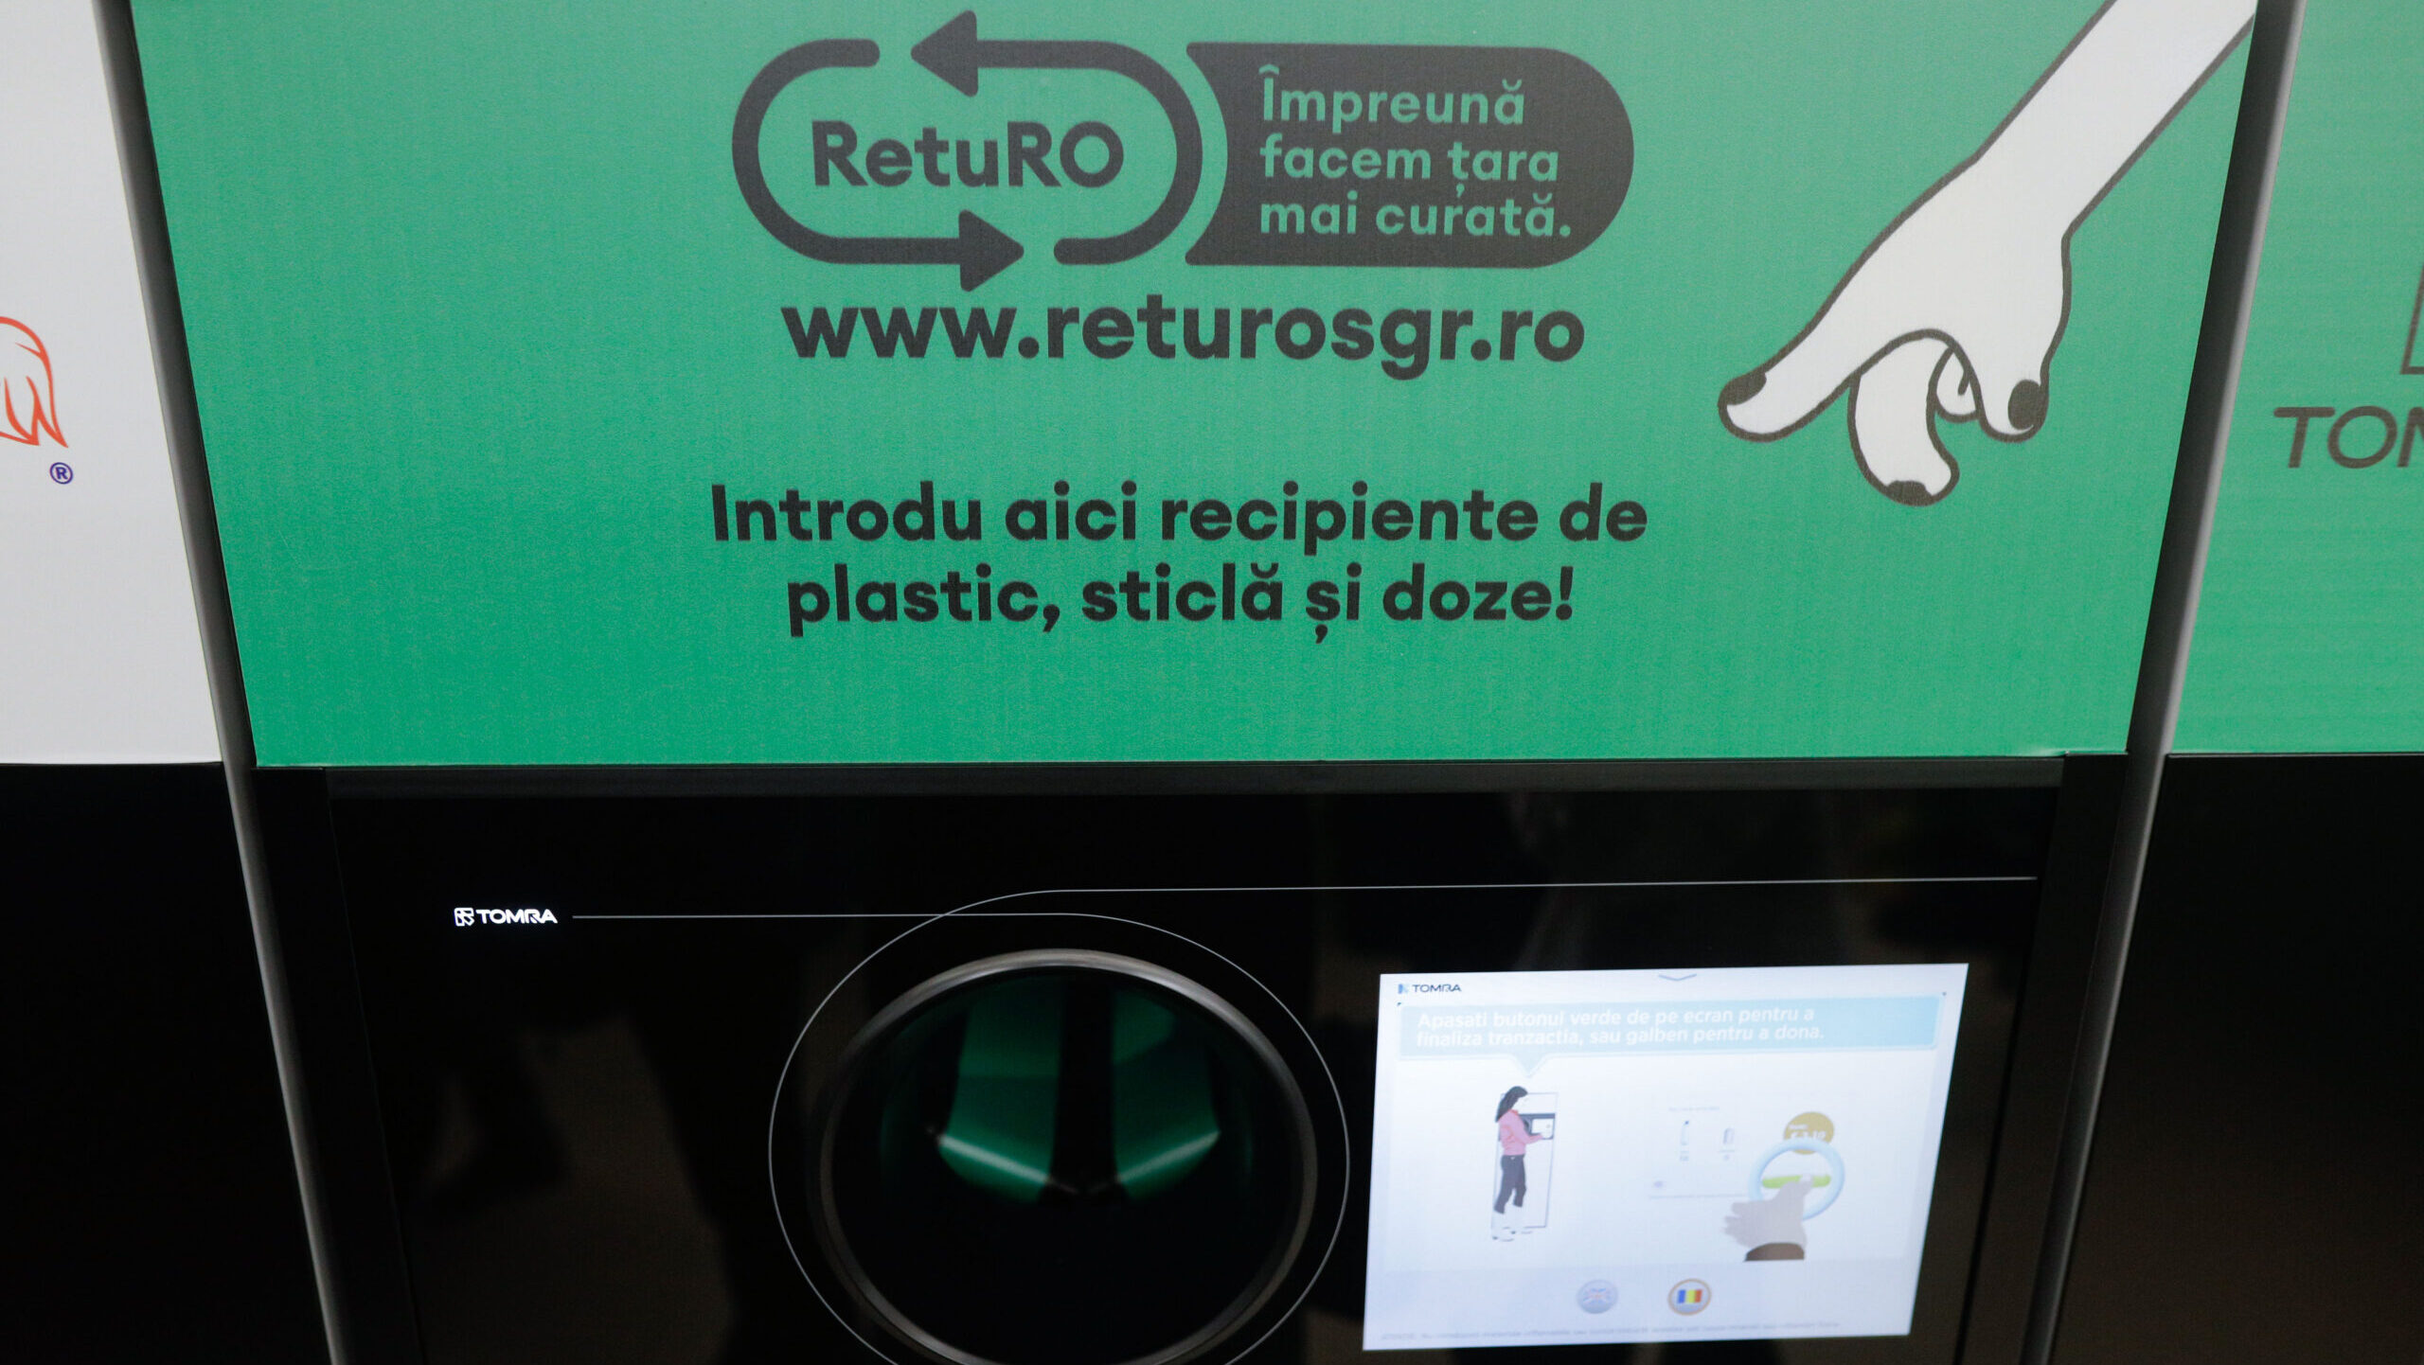

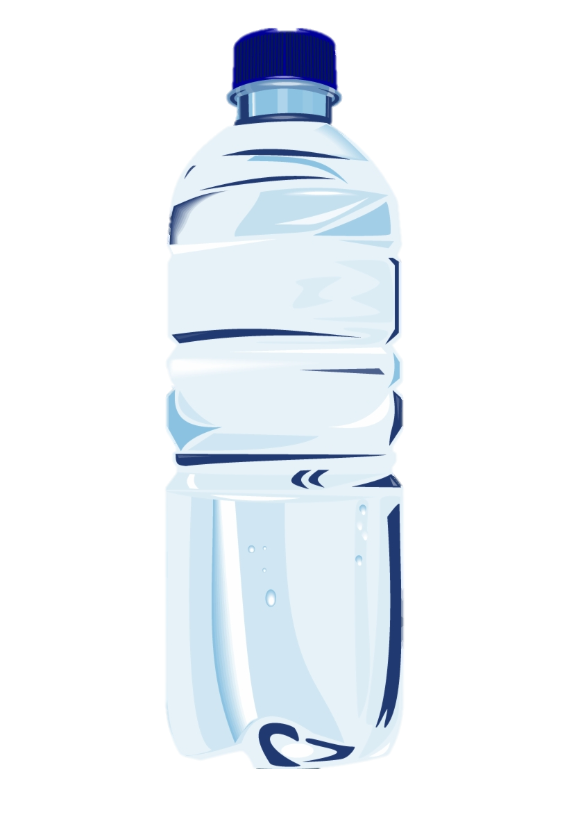

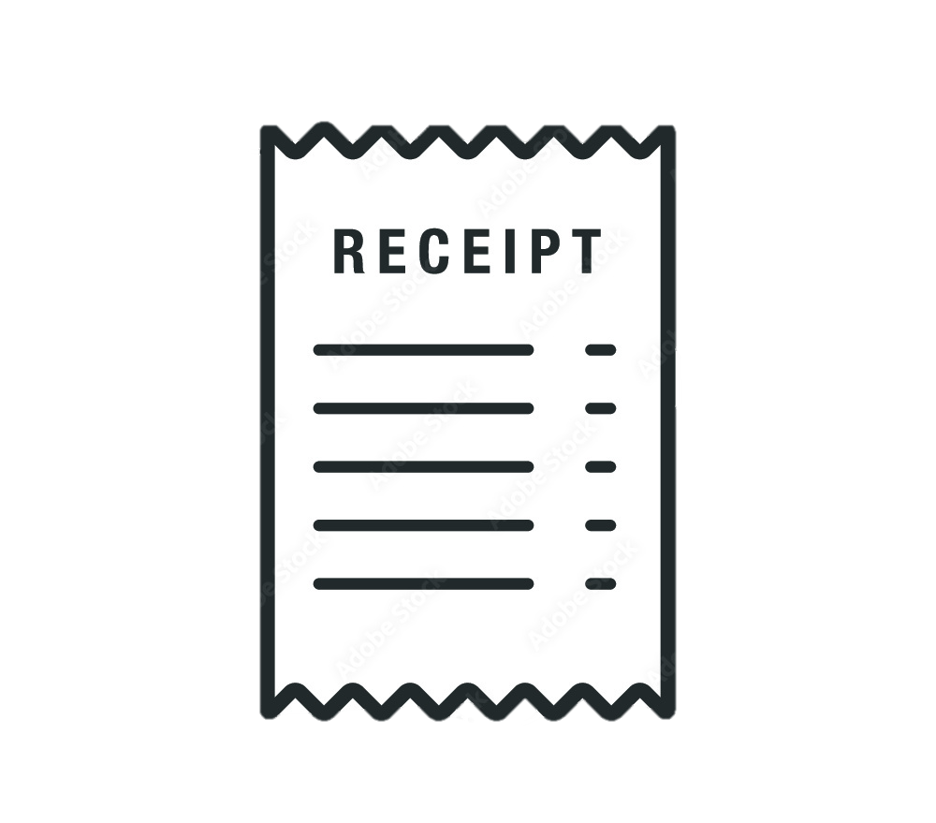
CLICK
0.50 RON
BACK TO SLIDE
DEMO OF A DRS SYSTEM

Slide 2
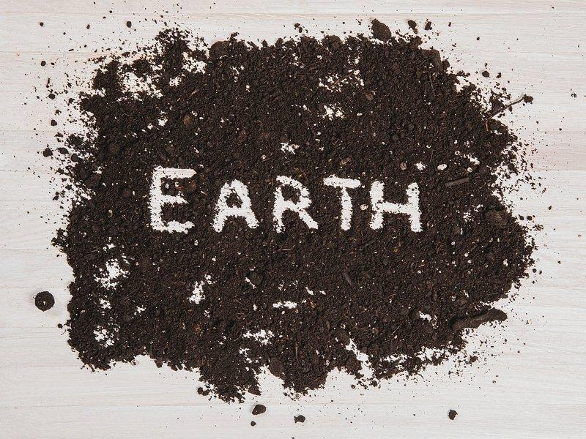
Campaign to Reduce Plastic Waste
Buzlea Dacian
Hadade Dragoș
Buzlea Dacian
Hadade Dragoș
1. What are the main sources of plastic waste?
Plastic waste comes from a variety of sources, and it's essential to target these areas for maximum impact:

Slide 3
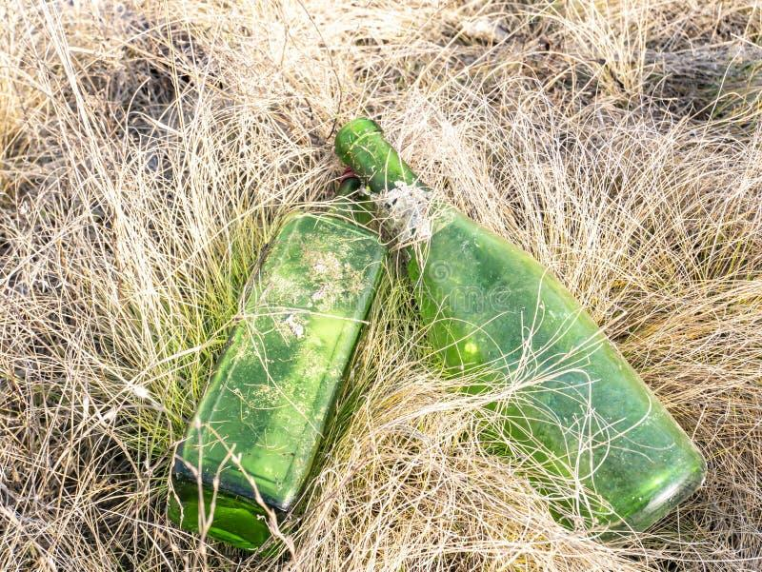
1. What are the main sources of plastic waste?
Plastic waste comes from a variety of sources, and it's essential to target these areas for maximum impact:
Single-use plastics: These include plastic bags, straws, bottles, cups, and utensils. They are commonly used once and discarded, contributing significantly to plastic pollution.
Packaging materials: Excessive plastic packaging in food, cosmetics, and retail products.
Fishing nets: Abandoned or lost fishing nets, also called "ghost nets," are a huge source of ocean plastic pollution.
Plastic bottles: A major source of waste, particularly water and soft drink bottles.
Single-use plastics: These include plastic bags, straws, bottles, cups, and utensils. They are commonly used once and discarded, contributing significantly to plastic pollution.
Packaging materials: Excessive plastic packaging in food, cosmetics, and retail products.
Fishing nets: Abandoned or lost fishing nets, also called "ghost nets," are a huge source of ocean plastic pollution.
Plastic bottles: A major source of waste, particularly water and soft drink bottles.

Slide 4

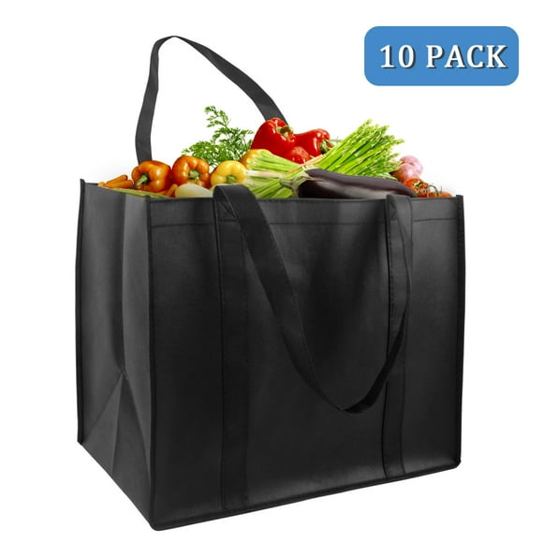
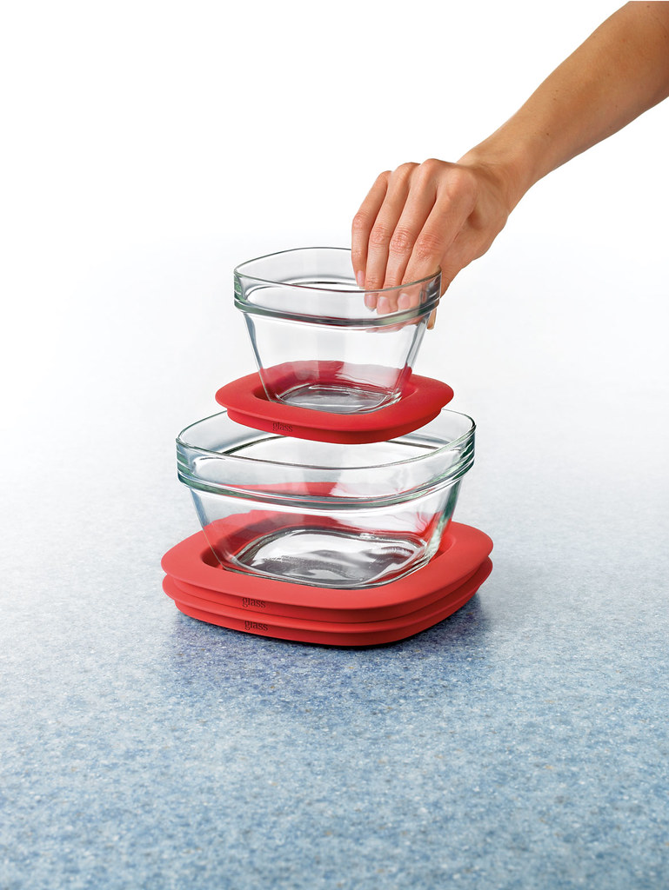


2. What alternatives can people use?
Encouraging the use of alternatives is a key component of reducing plastic waste. Here are some practical substitutes:
Instead of plastic bags, use cloth, canvas, or other reusable bags.
These can replace plastic bottles and food containers
Reusable shopping bags
Glass or stainless steel containers
Use products with minimal plastic packaging or refillable containers
Use products with minimal plastic packaging or refillable containers
Eco-friendly cleaning products
Wearing clothing made of natural fibers

Slide 5
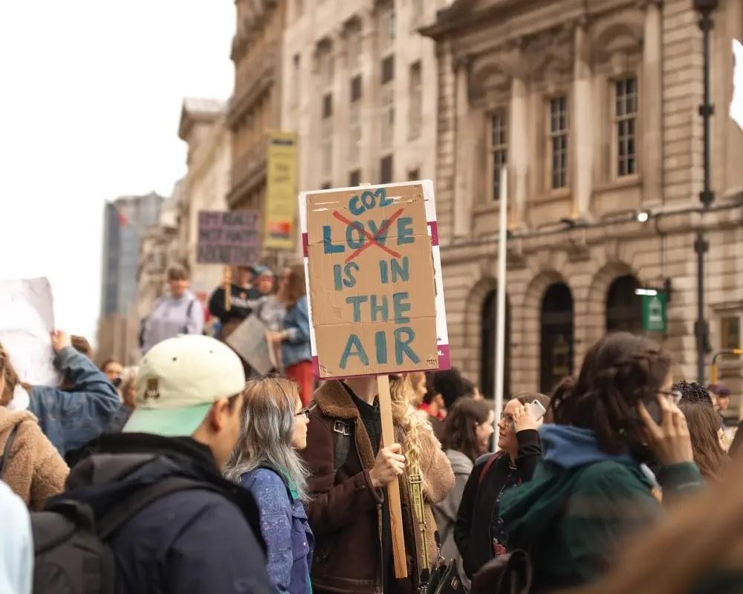
3. How will you convince people to take action?
Deposit Return System (DRS)
People need motivation to make a change, and that's where effective messaging and incentives come in. Here’s how to encourage action:
motivation
Education and awareness: Use powerful statistics and facts to make people aware of the environmental damage caused by plastic. Visual content like infographics, videos, and images of polluted environments can be particularly impactful.
Incentives and rewards: Offer rewards or discounts for people who bring their reusable bags or bottles to stores or participate in clean-up events.
Challenges and competitions: Engage people with fun challenges, like a „Plastic-Free Week” where people try to go an entire week without using plastic.
Government and business action: Advocate for legislation to reduce plastic production and increase recycling efforts, while encouraging businesses to adopt sustainable practices and packaging.
Local clean-up initiatives: Organize events like beach cleanups, where people can physically contribute to the solution while raising awareness in their communities.

Slide 6
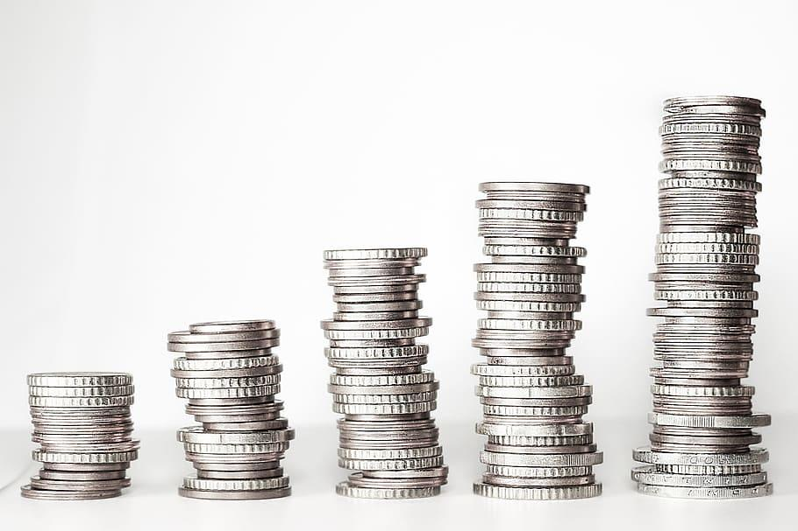
Deposit Return System (DRS)
The Deposit Return System (ro: SGR) was a key component of Romania's effort to tackle plastic waste. Under this system, consumers pay a small deposit when purchasing bottled drinks with the DRS symbol. Once the bottle is empty, consumers can return the bottle to a designated collection point (such as reverse vending machines or participating stores) in exchange for a refund of the deposit. The bottles that are returned are then recycled, reducing the amount of plastic waste that ends up polluting the environment. The collected plastic is cleaned, reused, and refilled, which helps to conserve natural resources.
The Deposit Return System (ro: SGR) was a key component of Romania's effort to tackle plastic waste. Under this system, consumers pay a small deposit when purchasing bottled drinks with the DRS symbol. Once the bottle is empty, consumers can return the bottle to a designated collection point (such as reverse vending machines or participating stores) in exchange for a refund of the deposit. The bottles that are returned are then recycled, reducing the amount of plastic waste that ends up polluting the environment. The collected plastic is cleaned, reused, and refilled, which helps to conserve natural resources.
BACK TO SLIDE
DEMO OF A DRS SYSTEM

Slide 7
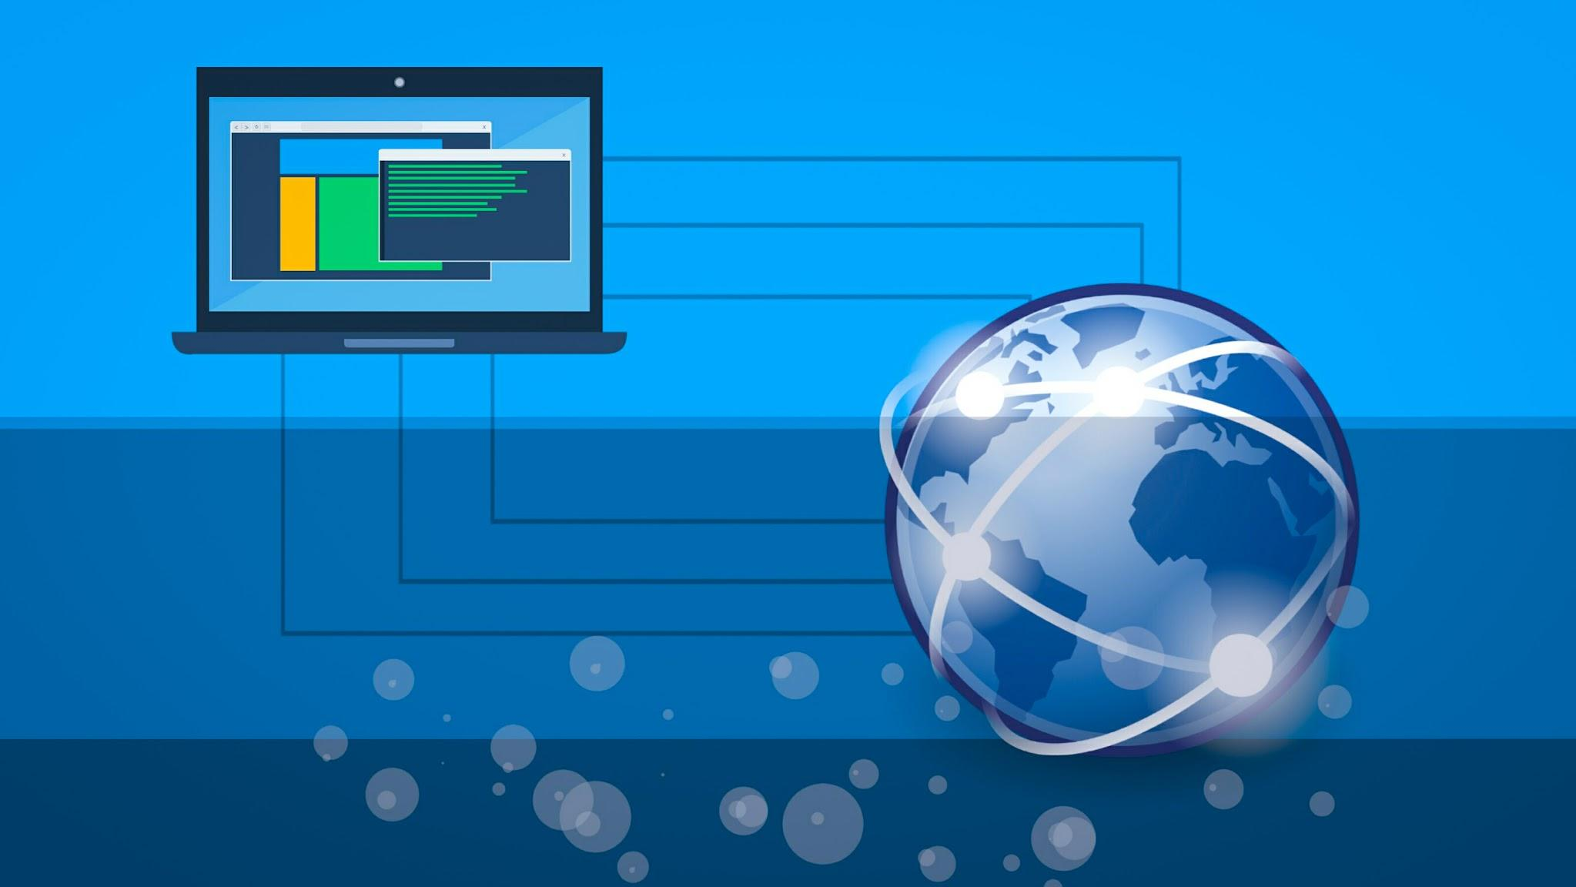
Webography
https://oceanservice.noaa.gov/education/tutorial_pollution/016youcando.html
https://returosgr.ro/
https://www.enelgreenpower.com/learning-hub/environmental-pollution
https://www.twinkl.ro/teaching-wiki/recycling
https://northhillbottledepot.ca/why-is-recycling-important-10-benefits-of-recycling/

Slide 8
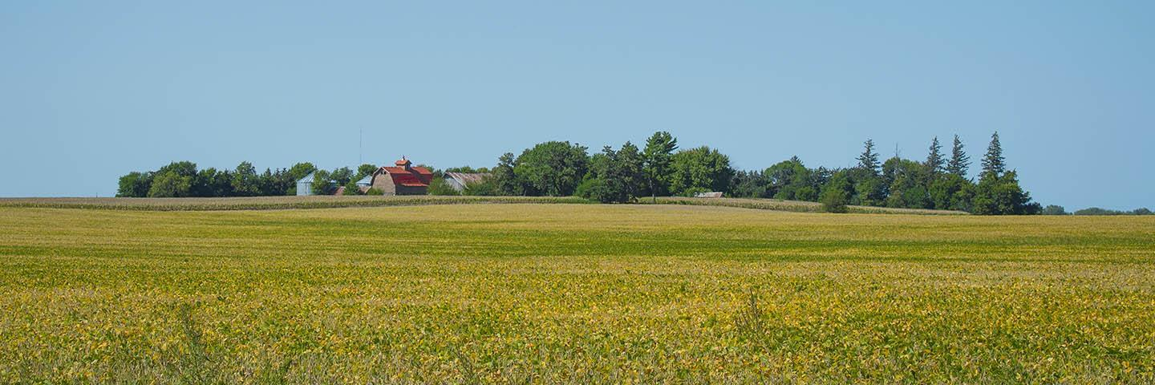

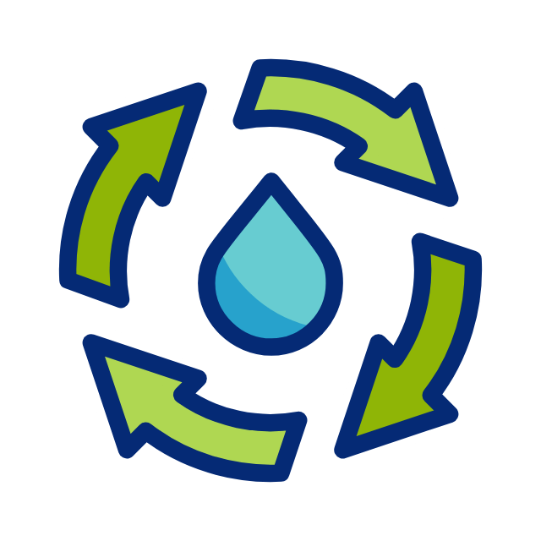
Thankyou for your attention!

